Slide 1

Discretionary Grant
Application Process 16/17
January 2016

Slide 2
Purpose of Presentation
To Inform Stakeholders :
- Overview of 15/16
- Applications Process - how to apply for DG Funding 16/17
- Funding categories

Slide 3
Overview of 15/16 Applications

Slide 4
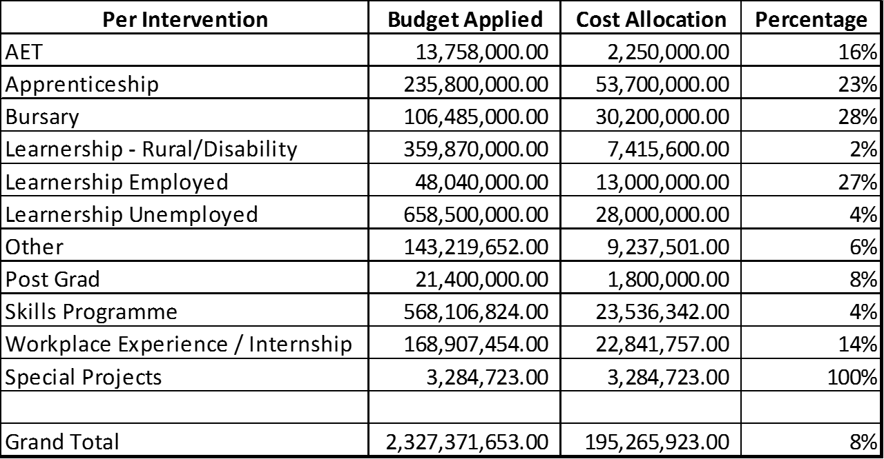
Overview of 15/16 Applications

Slide 5
Challenges
Some of the following challenges were encountered:
Invalid documentation (Tax clearance, etc.)
Outside FP&M SETA Scope
Incomplete / pending submissions.
Failure to meet deadline.
Over subscription (Statistics provided)
WSP and Pivotal Plan submitted and not approved
Projects applied for not linked to approved Pivotal Plan
Applications not addressing Scare and Critical Skills of the sector
Request for changes to funding awarded that ends up affecting targets
Unrealistic applications. i.e. Applying for 500 learners when our budget is for 600 learners

Slide 6
Outstanding Issues for 15/16
Discretionary Grant Funding windows opened annually parallel with Mandatory Grant from 01 January to 30 April
Process aligned to DHET reporting requirements
Projects implementation within each respective financial year
No 15/16 funding awards will be implemented in the 16/17 financial year
15/16 Funds not activated within February 2016 to be returned to SETA per MOA
Other funds unutilized from prior years to be automatically
swept after they have expired. Legally, no obligation exists
anymore to act on the contract.

Slide 7
Processing of Payments 15/16
Delays caused by:
Invalid Supporting documentation
Copies of identification documents that are not clear
Insufficient supporting documentation submitted for payment
Incomplete learner registration forms or incorrect forms completed
Forms not signed by the learners

Slide 8
Documents to have on hand
Valid Tax Clearance Certificate/Tax Exemption document
CIPRO/Government Registration
BEE Certificate
Bargaining Council certificate/exemption letter (where applicable)
Proof of accreditation
Letter/agreement appointing external training provider
Occupation Health and Safety Certificate
Documents to have on hand to be determined by the type of entity

Slide 9
Sources of DG Funding
SDL Contribution
20% of SDL Contributions to NSF
Are made up of surplus funding from unclaimed MG
Are made up of unused allocated DG funding from previous Financial Years
SETA Discretion
Funding used by SETA, at its DISCRETION, to address SSP priorities
Funding used by SETA to address Critical and Scarce Skills
80% of Skills levies paid to SETA: (20% mandatory grants, 49.5% to Discretionary Grants, 10,5% SETA Administration incl QCTO contribution)
Surplus Funds
15/16 funds that have not been activated by February 2016 will be taken back for redistribution

Slide 10
Purpose of DG Funding
Promote Skills Development in the FP&M SECTOR
Assist the FP&M SETA to meet Annual Performance Plan Targets
Implement meaningful Skills Development programmes in the Workplace
Skills Development
To assist unemployed people to gain access to Skills Development opportunities
National & Sectoral Priorities
To address national priorities as per NSDS III
Employed Individuals
Unemployed
Individuals
To address sectoral priorities as identified by FP&M SSP

Slide 11





How Does DG Funding Work?
Method of Distribution
Systems Developed
Invitation
Window Opens
Finance / Budget Available

Slide 12
Different Funding Types
PIVOTAL - Fixed DG Funding
Funding Type 2
  PIVOTAL -Fixed DG Funding
  NON-PIVOTAL & Special Projects

Slide 13
PIVOTAL Programmes
Fixed DG Funding
(Included in WSP Submissions)
Made up of 7 Different Funding Window Categories
Learnerships | Apprenticeships
Bursaries | Skills Programmes
Work Experience / Internship | Work – Integrated – Learning
Adult Education and Training (AET)

Slide 14
Funding Type 1 : PIVOTAL
Discretionary Grant Funding :
Fixed Windows

Slide 15
Learnerships
Learner Category | Maximum Cost Per Learner (VAT Zero Rated) | No. of learners | Applicant Category | Criteria
18.1. Employed 18.2 Unemployed | R 20,000 R 25,000 | 850 1815 | Private TVET Institutions - workplaces | SETA Accreditation Certificate Safety, Health & Environment Audit Report / SHE Compliant Certificate Learner Progress Report
 |  |  | WPP partnering with Public/ Private TVET | SETA Accreditation Certificate Outsourcing and Financial Agreement with TVET College Safety, Health & Environment Audit Report / SHE Compliant Certificate Learner Progress Report

Slide 16
Apprenticeships
Learner Category | Maximum Cost Per Learner (VAT Zero Rated) | No. of learners | Applicant Category | Criteria
18.1. Employed Section 13 18.2 Unemployed | R 50,000 (Per Apprentice Per Year : Max 3 Years at Total Cost: R 150,000) | 140 400 | Registered Sector Specific Trades Prioritized Engineering Related Trades | Printing & Packaging Trades Textile Trades Furniture Trades Millwright Electricians Fitters Turners Boiler Makers Mechanics Mechatronics Instrumentation
NB: The Following Changes have been effected on Apprenticeships:
  1. Apprenticeships Cost Increased :
  18.1 & 18.2 From R 46,450.00
  Both increased to R 50,000.00 Per Year : Max R 150,000.00

Slide 17
Bursaries
Learner Category | Maximum Cost Per Learner (VAT Zero Rated) | No. of learners | Applicant Category | Criteria
18.1 Employed | R 35,000 per learner (Per Year: Max 3 Years) | 100 | Under-Graduate Programmes | Tertiary Programmes offered at universities for 2015 academic year: National Diplomas, Degree Programmes Related to Industry Priorities: Disciplines such as publishing, science, engineering and technology
18.1 Employed | R 50,000 (Per Year: Max 2 Years) | 7 | Post-Graduate Programmes | Tertiary Programmes offered at universities for 2015 academic year: Honors, Masters, Doctoral Programmes Related to Industry Priorities: Disciplines such as publishing, science, engineering and technology

Slide 18
Skills Programmes: AET Programmes
Learner Category | Maximum Cost Per Learner (VAT Zero Rated) | No. of learners | Applicant Category | Criteria
18.1 Employed | R 3,000 | 750 | Workplaces | Occupationally-directed Education and Training Programmes: Numeracy, Literacy, Financial Literacy and Life Skills Proof of Registration with Umalusi and Dept. of Basic Ed.
 |  |  | Workplaces (may partner with private training providers) | ABET Programmes: Levels 1-4: ABET Programmes, Numeracy, Literacy, Financial Literacy and Life Skills Proof of Registration with Umalusi and Dept. of Basic Ed.

Slide 19
Skills Programmes:
Managerial & Technical Skills Training
Learner Category | Maximum Cost Per Learner (VAT Zero Rated) | No. of learners | Applicant Category | Criteria
18.1 Employed 18.2 Unem-ployed | R 7,200 Per Learner | 2250 850 | Workplaces | Managerial & Technical Skills Training (Employed): Credit Bearing Programmes, Related to Critical/Scarce Skills Credit Valued at R120 per credit Minimum of 60 Credits Proof of SETA Accreditation
 |  |  | TVETs / Training Providers partnering with Workplaces / Communities | Technical Skills Training (Unemployed) : Credit Bearing Programmes, Related to Critical/Scarce Skills Credit Valued at R120 per credit Maximum of 60 Credits Proof of SETA Accreditation Outsourcing Agreement

Slide 20
RPL (Skills Programmes
& Apprenticeship RPL
Learner Category | Maximum Cost Per Learner (VAT Zero Rated) | No. of learners | Applicant Category | Criteria
18.1 Employed | R 5,000 | 210 | Skills Programmes - Workplaces Apprentice-ships - Registered Sector Specific Trades (prioritized) | Technical Skills Training (Employed): Credit Bearing Programmes, Related to Critical/Scarce Skills Credit Valued at R120 per credit Minimum of 40 Credits Apprenticeship Trades Printing, Publishing & Packaging Trades Textile Trades Furniture Trades Assessment Methodology - RPL Proof of SETA Accreditation

Slide 21
Internships / Work Place Experience
Learner Category | Maximum Cost Per Learner (VAT Zero Rated) | No. of learners | Applicant Category | Criteria
18.2 Unemployed | R 15,000 (6 Months) R30,000 (12 Months) | 300 | Workplace Providers – learnerships / apprentice-ships | Occupationally-directed Education and Training: Unemployed Graduates at registered TVET/HET Institutions Duration of 6 months Proof of Recognised/Registered Qualification, Proof of Mentors
 |  |  | HETs/TVETs partnering with Workplace Providers | Occupationally-directed Education and Training: Unemployed Graduates at registered TVET/HET Institutions Duration of 6 months Proof of Recognised/Registered Qualification, Proof of Mentors Proof of WK agreement

Slide 22
Work Integrated Learning Programmes
Learner Category | Maximum Cost Per Learner (VAT Zero Rated) | No. of learners | Applicant Category | Criteria
18.2 Unemployed | R 15,000 (6 Months) R 30,000 (12 Months) R45,000 (18 Months) | 450 TVET 250 HET | Workplace Providers | Structured Experiential Learning: Unemployed students registered at TVET/HET Institutions, completing experiential learning internship component to obtain full qualification. Duration of 6 and or 12 Months Must be structured experiential learning programme Proof of Recognized/Registered Qualification, Proof of Mentors Proof of Recognized/Registered Institution
 |  |  | TVETs /HETs partnering with Workplace Providers

Slide 23
Funding Type 2 : Non-PIVOTAL
Discretionary Grant Funding :
Special Projects

Slide 24
Special Projects to Address Sectorial Priorities
1. High Level Skills Development Projects Linked to Sector Development
Address high level skills needs and sector development and innovation capacity
HET Institutions invited to submit project applications to address:
-Access to graduate/post-graduate programmes
-Increase work experience and experiential learning for students
To address scarce and critical skills of the various FP&M SETA sub-sectors including clusters or sectoral group projects.
2. Rural Development Projects
Funding is available to:
enhance skills development amongst unemployed people & address poverty alleviation.
Empower people through entrepreneurship.
3. Funding is also available for organizations training people/ workers living with disabilities
4. HIV/AIDS AWARENESS – funding is available for projects relating to HIV/AIDS awareness.

Slide 25
IMPORTANT NOTICE
The FP&M SETA will not allocate funding
from its 2016/17 budget to beneficiaries
who have not yet implemented (or
demonstrated sufficient progress with regards
to) projects allocated to them in 2015/16 or prior funded years.

Slide 26
Application Period
Opening Date : 1st January 2016
Closing Date: 30 April 2016 at 24h00

Slide 27
Application Process : Submissions
Method of Submission
Make Submission
Verify Submission
  Web-based electronic Submission
  Follow online guidelines
  Ensure submitted before deadline.
  Acknowledge-ment of submission received

Slide 28
Application Process : Evaluations
Evaluation
Recommen-dation
Approval
  Pre-eliminations
  Non-eligible criteria (invalid tax cert, outside FP&M scope, failure to meet deadline)
  Levy payers – approved WSP
  Board approves application – final decision
  Applicants notified in writing
  Applications verified & evaluated at regional level
  Applications recommended for approval to Board by Projects Committee

Slide 29
Contact Details
Johannesburg
  William Malema – 011-403 1700
  WilliamM@fpmseta.org.za
Cape Town
  Leigh Hayes– 021-462 0057
  LeighH@fpmseta.org.za
Durban
  Lungile Shabangu– 031-7024482
  LungileS@fpmseta.org.za
REGIONAL OFFICES
HEAD OFFICE
Projects
  Kennedy Matodzi –
  011 403 1700
  KennedyM@fpmseta.org.za

Slide 30

Questions & Answers

Slide 31
Closure
Thank-you

